Slide 1
In the Woods of Memory （2009; 2004-7 serialization) Medoruma Shun (1960-)
目の奥の森
目取真俊
Notes:
First full length novel from Okinawa to be translated in English.

Slide 2
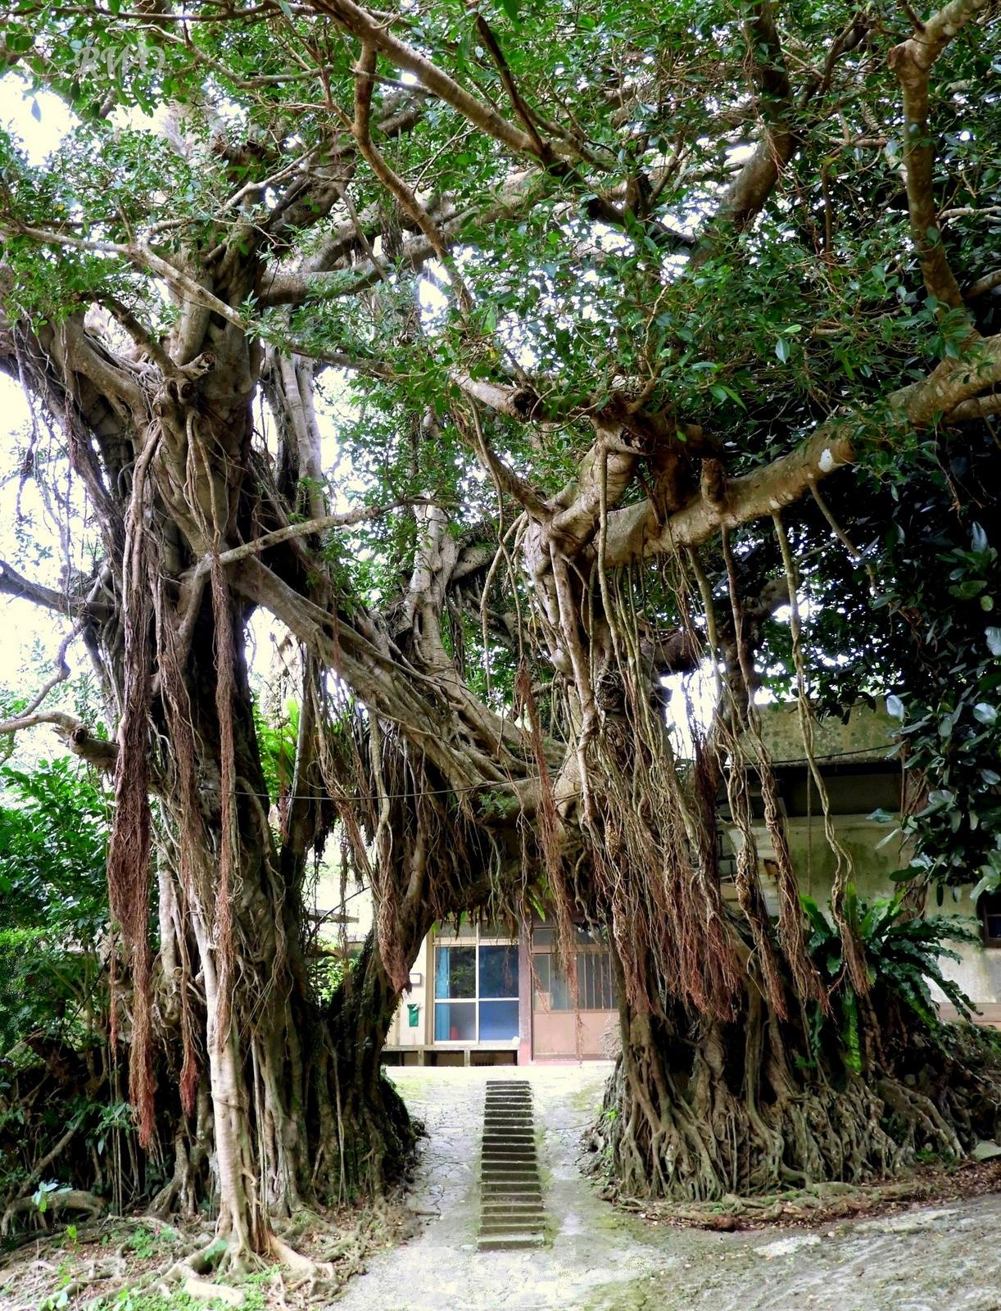
Banyan/ Gajimaru

Slide 3
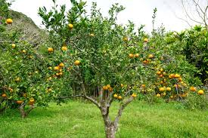
Tankan citrus tree

Slide 4
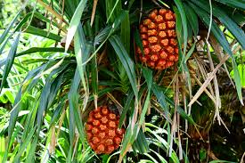
Screwpine

Slide 5
Keywords
War memory; private stories of guilt; Katsuyama Incident
Narration & Point of view (Faulkner, Sound and Fury)
Rape (Kôno Taeko quote)
Village/island conflict
Symbols (screwpine, pendant, orange trees, banyan)
Trees
Effects of trauma (spatial, temporal); 9/11 (ongoing global military actions)
Conservative, nationalist political backdrop (Ôe, museum displays, textbooks)
Nisei interpreters
Notes:
“I mean this in only the most abstract sense, but when we lost the war it might have been best had the victors raped every woman in Japan.”
1998, 1945 bodies unearthed

Slide 6
Discussion Questions
1. What kind of character is Seiji? How is he viewed by others?
2. Why is there no chapter that offers Sayoko’s point of view? Is she depicted positively or negatively?
3. What is the significance of the chapter on bullying?
4. What is the effect of the chapter that includes the author as a character?
5. How does Yôichi (Fumi’s son) differ from the junior high school students who are Tamiko’s audience for her “peace education” talk?
6. What problems does the rape of Sayako cause on the island/village?
7. Does Sayako have any agency?
8. How is the landscape of the island described?
9. What, if anything, connects the Battle of Okinawa to 9/11?
Notes:
Silence: beyond words; Adorno: after the Holocaust poetry impossible

